Slide 1


Career Guidance
Liveness Banda, PhD.
LUANAR Bunda Campus, Lilongwe
Presented at SCOM Secondary School Leavers Conference held at Nazarene Technical College, Lilongwe, 17-20th July 2025
Theme: “Pressing On Towards the Goal…”
(Philippians 3:13-14)

Slide 2
Outline
Introduction
Biblical Perspective of Careers
Career Choices
Principles of Career Choices and Management
Practical Considerations
Applying for University Programs
Key facts
Conclusion

Slide 3
Introduction
Theme: Philippians 3:13-14 – Pressing on towards the goal
Brothers, I do not consider that I have made it my own. But one thing I do: forgetting what lies behind and straining forward to what lies ahead,
I press on toward the goal for the prize of the upward call of God in Christ Jesus
What is the ultimate goal? Be with Jesus eternally,
While on earth, our goal/dream/vision is to work and serve Jesus with every opportunity – Great Commission
please Him, make Him known including in all we do including in our careers

Slide 4

Career Guidance

Slide 5
Biblical perspective about careers
Do we find careers in the Bible?
Yes
God mandated man to work for survival – Gen 3:17-19
From there we see different careers
What were the careers of the following?
Adam, Noah, Abraham, Lot, Jacob, Joseph, Bezalel, Aholiab, Paul, Peter, Luke, Nehemiah, Zaccheus

Slide 6
Biblical perspective about careers
What careers do we find in these scriptures
Exodus 31:1-6; 2 Kings 22:6; Acts 18:1-3; Acts 9:39; Mat 25:27
We are made to work hard
Prov 6:6-11; 2 Thes 3:10-12
Work was created by God – no work, no food
Paul, a good example – 1 Thes 4: 10-12; 1 Cor 4:12
Rest
Part of ten commandments – Exodus 20:8-11
Good for our refilling and remaining effective – connect to God
Make it a habit

Slide 7

Career Choices
There are many career choices
Success is determined by several factors
Interest
Planning
Goals
Skills
Salary
Preparation
Education

Slide 8

















What are you interested in?
Transportation
Building and fixing things
Food
Maths
Teaching
Computers
Sports
Media
Managing money
Healthcare
Helping your community
Social studies
Reading
Music and art
Law
Nature
Science

Slide 9
Careers can be described in OCCUPATION GROUPS
Architecture and Engineering
Arts and Design
Building and Grounds Cleaning
Business and Financial
Community and Social Service
Computer and Information Technology
Construction and Extraction
Education, Training, and Library
Entertainment and Sports
Farming, Fishing, and Forestry
Food Preparation and Serving
Healthcare
Installation, Maintenance, and Repair
Legal

Slide 10
Careers can be described in OCCUPATION GROUPS
Life, Physical, and Social Science
Management
Math
Media and Communication
Military
Office and Administrative Support
Personal Care and Service
Production
Protective Service
Sales
Transportation and Material Moving
List not exhaustive

Slide 11
Principles of career choice and management
Self-assessment
Research
Alignment with Goals and Values
Skills and Education
Market Demand
Networking
Work Environment
Work-Life Balance
Financial Considerations
Adaptability and Lifelong Learning

Slide 12
Practical issues to consider for career choices
Guide #1: Choose a career that is something you really like to do.
Guide #2: Do your research and choose carefully, thoughtfully and prayerfully.
Guide #3: Make it meaningful to you and your call.
Choosing is hard but exciting
Chance may play a part, preparation is better
You owe it to yourself and God to look for work that is meaningful, rewarding and within God’s will (your calling)! … take responsibility

Slide 13
Choose Career Options That Match Your Values
Knowing what you value most will help you refine your career search and choice:
Serving God
Helping others
Prestige
High income
Flexible work hours
Establish and align values, career choice, and career goals for motivation.
There is no substitute for "knowing yourself."

Slide 14
Surviving in a Fast Economy
You will always have some control over your career.
You must accept risks and plan for the future to advance your career.
A college degree does not guarantee employment.
A commitment to lifelong learning will help keep you employable
Consider wealth creation besides looking for employment
Do not take God out of the picture
The more you know,
the greater your marketability.

Slide 15
Factors to Consider
Do:
explore a number of careers and majors
Get involved
Get advice from people in your target occupation
Follow your passion with God still in the picture
Dare to try something new
Don’t:
focus on a major just to get a career out of it
select a major just because it is “cool” or seems to promise prestige
let someone else push you into a job
Assume that you have it all figured out

Slide 16
Where to Go for Help
Career Masters/Mistresses
Teachers
Role models/mentors
Upper-class students
SCOM associates
Placement services (Attachment)
Ask someone in your chosen field:
How did you find your job?

Slide 17
Become Knowledgeable About Careers
Explore from the internet, newspapers /
Research several careers, not just one
Browse the Careers section of magazines, publications
See a career counselor/teacher/associate
Scope out Internet resources
Network--many people love to talk about
their jobs!
Know your options...

Slide 18
Select Several Careers, Not Just One
It’s a good idea to have several careers in mind rather than just one.
It pays to be knowledgeable about more than just one career field.
It also pays to develop a wide variety of general skills, particular those related to communication.
Keep your options open...

Slide 19


Form meaningful networks!
Check with people you know about career information.
Networking can lead to meeting someone who may be able to answer your questions about a specific career or company.
It is an effective way to learn about the type of training necessary for a particular position, what it took to get into the field, and the positive and negative aspects of the work.
More and more professionals are active on online networks such as LinkedIn.com.
Some professionals even use Facebook to get in touch with others in their field…as well as research potential candidates.

Slide 20
Assess Your Skills
Academic Strengths
Reading, Writing, Speaking, and Listening
Math
Creative Thinking
Problem Solving and Decision Making
Personal Qualities
Self-Esteem, Self-Management, Responsibility
People Skills
Social, Negotiation, Leadership, Teamwork

Slide 21
Getting Experience
Volunteer or service learning
Study abroad
Internships
Student projects/competitions
Research
On-the-job training
Apprenticeships
Nothing teaches like experience.

Slide 22

Research the Job
Identify the skills and experience necessary to perform the job you want.
Determine the general requirements of the job.
Learn about the day-to-day tasks and responsibilities.
Research the company and employer.
Determine the company’s philosophy.
The more you know about the job, the stronger the candidate you will become.
How big will my office be?

Slide 23
What practical things can help you succeed
Set goals
Work towards goals
Consult relevant people
Work hard
Be contented
Time management
Good Character – treat yourself and others well

Slide 24
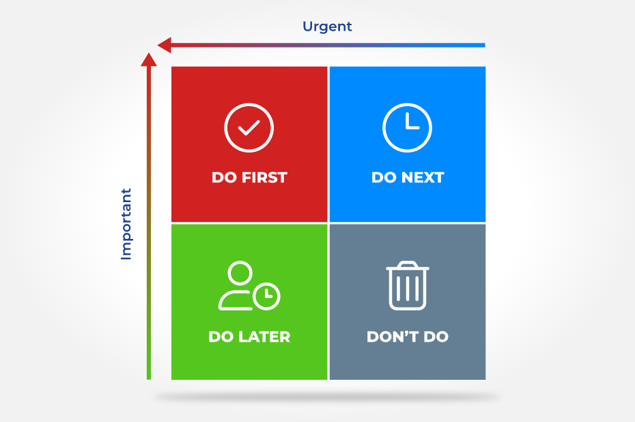
Time Management Matrix
Time Management

Slide 25

Time management Matrix

Slide 26
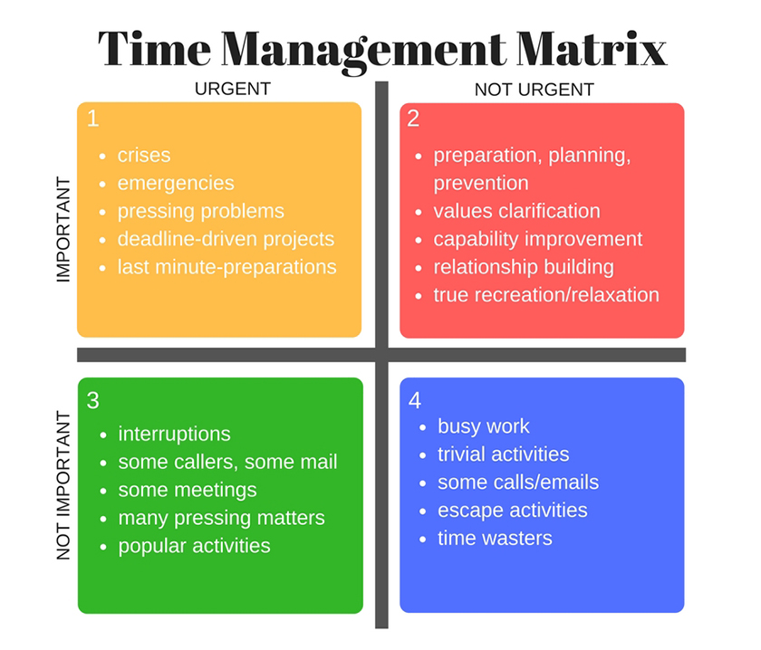
Exercise
List personal activities that should go in box 1, 2, 3 and 4.
What are the barriers and motivations you face in allocating time and energy for these activities?
Which box will you focus on most
How will you overcome them?
Discuss with someone

Slide 27

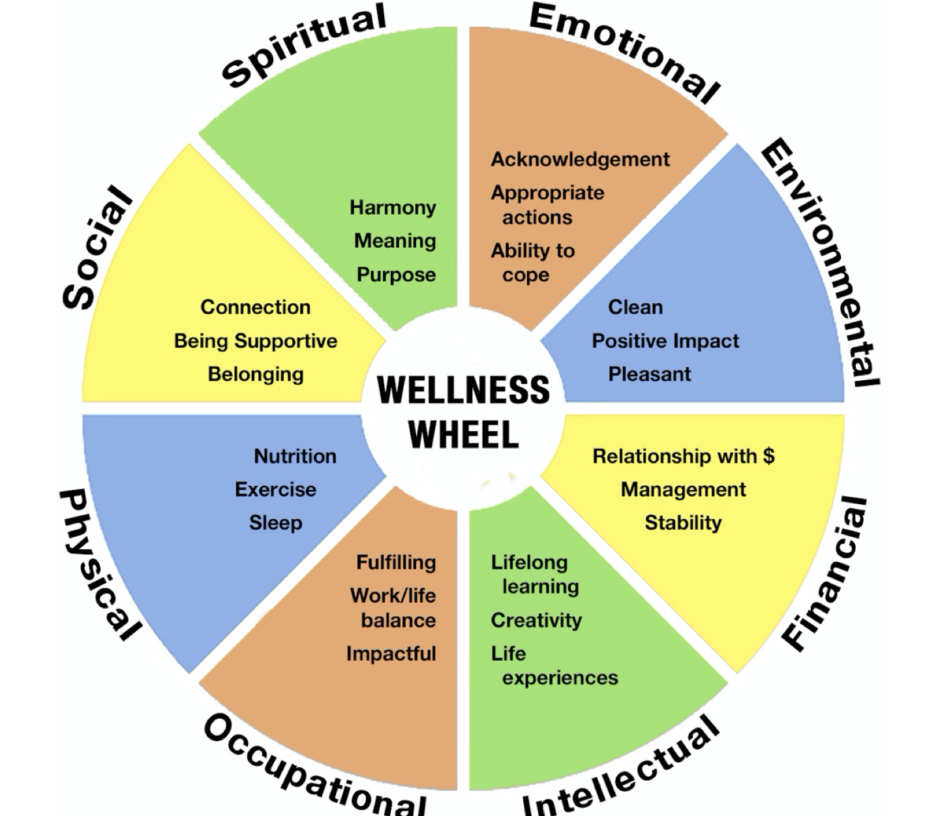
Career- Spiritual Life Balance
Knowledge gained must be linked to our calling and life purpose
Career success without Christ is fruitless
Successful believers cannot be salt and light without a deep spiritual life
Allocate time to activities
Do not compartmentalise self

Slide 28

Principles Career- Spiritual Life Balance
Prioritization
Time Management
Integration of Values
Mindfulness and Reflection
Seeking Support
Setting Boundaries
Engagement in Spiritual Practices
Embracing Diversity
Self-Care
Flexibility and Adaptability
Embrace the principles. Strive for a balance
This will cultivate a sense of fulfillment, purpose, and harmony in your personal journey of growth and discovery

Slide 29
Applying for University Programs
Know the universities
Public: LUANAR, KUHeS, UNIMA, MUST, MZUNI, MUBAS
Private: MAGU, UNILIA, MAU and many more
Spend time to look at university websites
They show programmes on offer.
most of the universities have over 50 programmes
Diplomas, BSc, BA, PG Diplomas, MA, MSc, PhD
Selection is the through National Council for Higher Education (NCHE)
The competition is tough, use mock and MSCE results to guide realistic choice
There are also ODeL programs

Slide 30
Applying for University Programs
All applications are done online
Managed by NCHE – visit NCHE website
There is a video that NCHE uses for info on online system
Check for it on YouTube: https://www.youtube.com/watch?v=lMerFyyhBek
Use actual information when applying.
Do not try out. If you try it will block you. Be ready before you start
NCHE needs and uses this information: an accessible phone number and working email

Slide 31
Applying for University Programs
Those with special needs - disability, for the selection
it's important to get a medical report or
a report from your school with a signature and a stamp
After application, the system gives you an invoice number.
Keep it safe and use it for payment to Mpamba, FDHBank, National bank, NBS Bank, Standard Bank, or any payment platforms that NCHE will give officially
Beware of fraudsters!
The spaces at the university are few, know there are some good private universities available.
E.g. Catholic University, Livingstonia University, African Bible College, Malawi Assemblies of God University, Malawi Adventist University, UNILIA
Other Colleges: Nalikule, Domasi CE, MCHS
TEVET colleges - NTCs

Slide 32
Applying for University Programs
Overall Cut off points
Boys <20
Girls <23
Programs are in clusters and usually cut off points are related.
Clusters e.g. Health, engineering, social sciences, business, education.
Student choices should at least be in 2 or 3 clusters
MBBS <10
Other Programs at KUHES <12
Most Engineering Programs <16

Slide 33
Applying for University Programs
Be proactive and objective
Follow instructions
Beware of scammers
Know institution accredited by NCHE
Making reading habit – useful information
Follow current affairs
Lookout for press releases – adverts, selection, loans, opening dates, etc.
Follow relevant social media pages
DO NOT MISS ANY INFORMATION – BE VIGILANT - ASK!

Slide 34
Key facts
Knowing God makes a difference in
Our understanding
Our focus
Our drive
Integrating God in everything
We need to be deliberate

Slide 35
Key facts
We do not live life alone but we have responsibilities at every stage
Not seeing others as competitors but complementors
You lose out if you don’t connect
Other people help to shape us – teachers, parents, siblings, peers, children, bosses, workers

Slide 36
Key facts
We need to be deliberate and systematic to grow and develop
We need to seek help sometimes, do not wait too long!
We need to offer help sometimes, offer it unreservedly
It's never too late to start any of these

Slide 37
Conclusion
Life is a process with various components and is lived with others (interdependency)
Must be lived excellently as a whole
Each life component has a right place, must be nurtured to grow and develop
Neglecting one part has consequences
Some consequences are temporary, others are permanent, while others are eternal
We must be wise and persistently pursue excellence in our careers with Jesus!
God enables us to be excellent in our careers for His glory
DO NOT ACT OUT OF DESPERATION! HAVE FAITH

